Slide 1



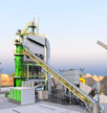
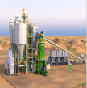
Cemos Group PLC

Slide 2
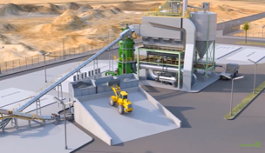
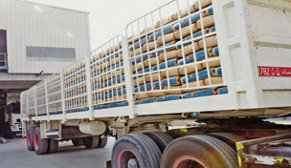



CEMOS Group Plc
Investment Overview
Cemos Group Plc – Cement Company focus Mobile & Modular Cement Grinders (CCG) in Niche Cement Markets
Production launch CCG1, Tarfaya, Morocco – Fully Licensed, Plant Purchased and 1st Cement Production launch 2018
CCG Plant Deployment, CAPEX and Payback – 12 months Plant Deployment, CAPEX & OPEX €11M, NPV €50M
Roll Out Program Phase 1 – Morocco & Sub Saharan Africa for up to 5 x Cemos CCG grinders with 270.000 tpy capacity
Convertible Issue – CCG1 Production Launch & Working Capital, Phase 1 Roll Out, Pre Money CV Option €18.6M
Cemos Background & Phase 2 – Founded 2011, 2 bn tons Limestone & Oil Shale Licenses for Cement & Clinker, Phase 2

Slide 3
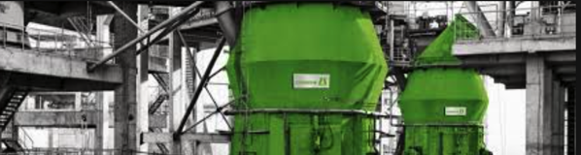
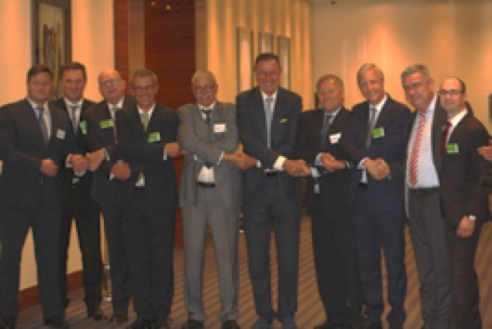

Loesche GmbH
World Leader in Cement Grinding
Loesche is the worlds leading manufacturer of cement grinding plants – 55% market shares, 111 years history
Market leading proven VRM grinding technology – Loesche Vertical Roller Mills are reliable, high out put, low energy
Market presence and experience – Loesche has executed a large number of EPC projects in Morocco and Africa
Cemos and Loesche in co-operation – 1st Cemos cement plant (CCG-1) in progress, framework for 5 x CCG plants
Financing – Cemos financing €4.5M (54% EPC delivery) for CCG1 plant, €2.8M Annuity Loan and €1.7M Deferred Payment
O&M – Primetec for O&M services for CCG-1 in Tarfaya, initial 12 – 18 months, including training, production control
Dr Thomas Loesche & Cemos Signing Event

Slide 4
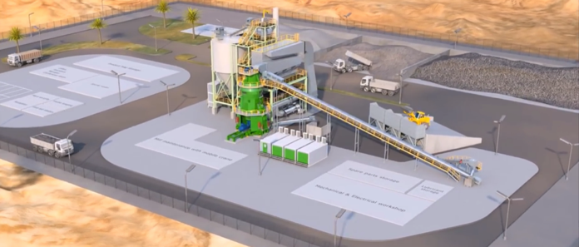


CCG Cement Grinding Plant
Mobile and Modular 270.000 ton Plant
Compact Cement Grinding (CCG) launched in 2016 – a new low CAPEX business model for cement markets
Market Entry plant for niche markets – Production capacity 270,000 for niche markets or single large scale infra projects
Fast deployment and investment cycle – 12 months post licensing deployment for production, 11 weeks on site assembly
Potential for quick payback and low breakeven – Investment payback potential 2-3 years, 25% capacity use BE
Suitable for Morocco & Africa niche markets – Africa’s shallow ports 5m suitable for clinker supply, secondary cities

Slide 5
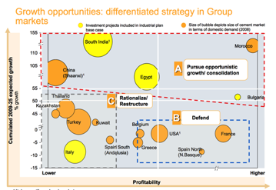
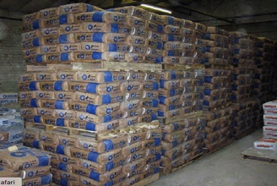
Cement Sector for Investing
Seeking High Value Niche Markets
Highly concentrated industry & with entry barriers – Cement majors as main players, regular new plant CAPEX $100M
Integrated Producers (ICP) vs. Cement Grinders – ICPs excess production of Clinker, sold at low cost to Cement Grinders
Production and Markets are local – Regular radius for cement sales is 150km in sparsely populated areas up to 600km
Substantial variations in cement markets – Emerging markets i.e. Africa lead growth markets, Western markets mature
Stable and long term cashflows – Cashflow profile target for long term and stable, utility type cashflow patterns
Cemos niche cement market focus – Growth markets with 250kt – 1Mt cement demand vs. Majors 1Mt min hurdle

Slide 6




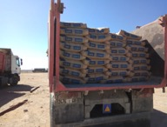
Morocco Cement
High Value Cement Market in Growth Economy
Stable and growing economy – Morocco has as one of the few countries in Africa an investment grade rating (BBB-/Ba1) and growing economy in a stable environment (GDP 4.5% 2015, 1.1% 2016m 3.8% 2017e)
Moroccan cement market is protected from imports – Cement industry had 22Mt capacity and 15Mt sales (70% capacity use) and only 4 producers; Lafarge Holcim Maroc, Heidelberg Ciments du Maroc, CIMAT and Asment Temara
Price stability in Morocco cement prices – Due to controlled number of producers and Lafarge Holcim Maroc 50% market dominance (post Lafarge / Holcim merger) the cement market prices are stable and current wholesale price MAD 1,300 (€117) per ton
EBITDA Margins High – EBITDA margins in Morocco are high and vary from 25% – 35% for local cement producers and key strategic market for Lafarge and Heidelberg
Morocco is the 2nd Largest Pan African Investor – Morocco and its industry is a leading investor in North & Sub Saharan Africa, in particular West Africa, and has a skilled work-force for regional expansion, supported by Moroccan banks & insurance co’s
South Morocco is a Niche Long Term Growth Market – South areas of Moroccan Sahara, ranging from Agadir to Dakhla represent 50% of the country’s land area but only 3% of population and is seen as Morocco’s gateway to Africa and growth area for cement, boosted by €7.7 billion in new government financed infrastructure projects

Slide 7
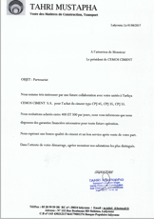
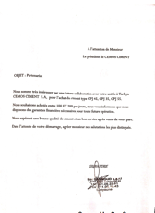
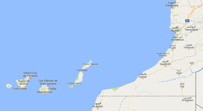
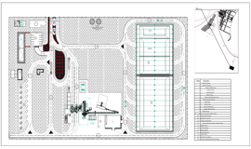
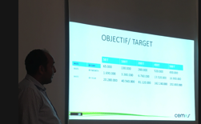
Tarfaya Cement Production (CCG1)
New Launch in Morocco´s Growth Market
Key Licenses secured by Cemos Ciment S.A. – 8 month program to follow for civil works completion, plant assembly and production start June 2018
South Morocco Areas Cement Growth Market in Morocco – Moroccan Government launched €7.7 billion investment program for 10 years for South Morocco and current lack of cement in the market
Tarfaya is a special tax free area – Morocco VAT 20%, corporate tax 30% or income tax 30 - 50% (Tarfaya excempt area)
Market growing with 2 or 4 Moroccan producers present – Ciments du Maroc Heidelberg present (Indusaha subsidiary with 500.000 tpy cement grinding) and Lafarge Holcim (launched 200.000 tpy cement grinding 2017)
Pre-sales for Cemos Production – Conducted a pre-sales program for 18 months and non binding Letters of Interest for more than 224.000 tons annual (Cemos Ciment S.A. Base Case Projections)

Slide 8
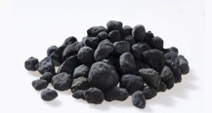
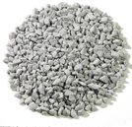
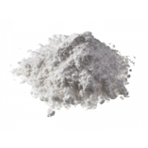


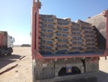
Tarfaya Cement Production (CCG1)
Cement Sales EBITDA Margin and % (€)
EBITDA Margin per ton | MAD* | EUR
Morocco Cement Price per ton | MAD 1,300 | €117
Cemos Sales Price (incl. 5% wholesale discounts) | MAD 1,240 | €112
- Raw Material Clinker, Limestone, Gypsum, Kraft Bags | MAD 605 | €54
- Cement Tax Morocco Cement Production Tax | MAD 150 | €13.5
- Production Electricity, Labour, O&M | MAD 122 | €11
- Other Sales, Marketing, Administration | MAD 42 | €4
EBITDA margin per ton | MAD 321 | €29
EBITDA Margin % | 26% | 26%
Cemos CCG Cement Plant Production Capacity
Cement Production per Hour | 45 tons / hr
Max. Production Hours per Year | 6,200 hrs
Max. Cement Production per CCG Plant | 279.000 tons

Slide 9
Cemos Tarfaya Cement Production
Cement Sales & EBITDA (€)

Slide 10
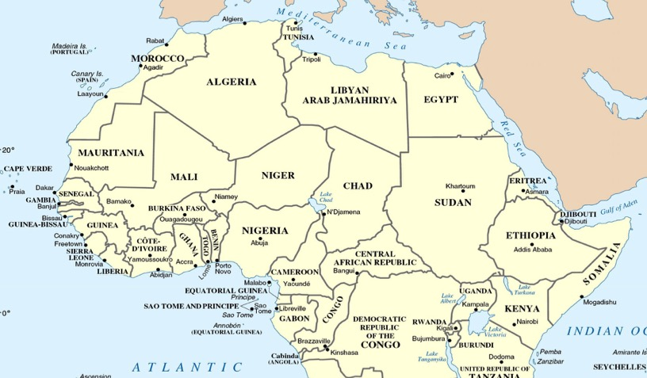
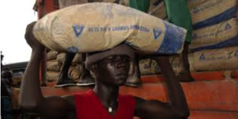
CCG Roll Out Program
Niche Market Locations in Evaluation
COUNTRY | AREA | POPULATION
Morocco | Tarfaya | 800,000
Morocco Morocco Guinea | North Morocco Sous Massa Kankan | 1,000,000 1,500,000 2,000,000
Ivory Coast | Daloa | 630,000
Ghana Canary | Kumasi Arinaga | 450,000 2,000,000
Mali | Bamako | 2,750,000
Tanzania | Dodoma | 2,000,000
Cemos CCG 1: Tarfaya, Morocco CCG 1 location and cement production launch 2018
Cemos CCG 2 – CCG 5: New locations in evaluation for CCG 2 – CCG 5 launches

Slide 11
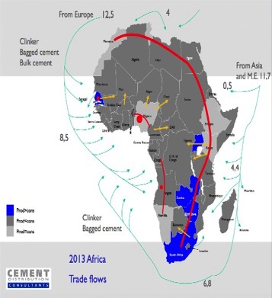
Africa Cement
High Population Growth Driving Markets
Population growth – Sub Saharan Africa population growth to 1.2 billion and + 40% by 2025 driving need for housing and cement consumption
Low per capita cement consumption – Sub Saharan Africa cement consumption varies from below 100kg to 200kg per capita vs. North Africa with 500kg per capita
Markets are Scattered – African disbursed markets are suited for a smaller scale 270,000 tons per year CCG grinder and a number of secondary cities as target
Cement Import Restrictions a Trend – Trend for protecting local cement markets with cement import restructions current, a CCG is FDI and clinker imports not restricted
High Prices in Select Sub Saharan Markets – Due to lack of cement supply a number of countries and regions have high (US$ 150 – 400) per ton cement prices
Africa Cement Demand Map

Slide 12
Cemos CCG Roll Out Program
Morocco and Sub Saharan Africa
2017
2018
2019
2020
2021
2022
Financing:
1. Cemos CULS
2. Loesche Loan
3. Bank Loan
CCG 1 Tarfaya
Production Launch
Financing:
1. Cash Flows
2. Cemos CULS
2. Loesche Loan
3. Bank Loan
CCG 2
Project Execution
IPO
CCG 3
Project Execution
CCG 4
Project Execution
CCG 5
Project Execution

Slide 13

CULS and Equity Conversion Exit
Casablanca Stock Exchange IPO
Cemos CULS Investment Exit Options – Repayment of CULS loan at maturity in cash or at investors choice conversion into Ordinary Shares of Cemos Group Plc at lower of €0.20 per share or 20% discount
Casablanca Stock Exchange (CSX) – Casablanca Stock Exchange is the largest listed market in north Africa and a leading Pan-African stock exchange for companies in Africa with 100 companies listed, €60 bn market cap
Cement and Building Materials as a Main Sector on CSX – Listed cement companies in Morocco (Lafarge Holcim Maroc, Ciments du Maroc) have high valuations of 12 x EV / EBITDA and 22 x P/E reflecting the high profitability in the Moroccan cement markets
Cemos IPO on CSX or London Stock Exchange – Cemos is seeking an IPO for creating liquidity for its shares and financing its growth in 2–3 years on Casablanca or London Stock Exchange
Company | Price, MAD | Shares (m) | Mkt Cap ($m) | Revenue ($m) | EBITDA, ($m) | EBITDA margin | EV / EBITDA | EPS | EPS growth (5 years) | P / E | P / B (MRQ)
Morocco
Ciment du Maroc (2016) | 1,290 | 14.44 | 1,825 | 367 | 173 | 47% | 10.5 | 76 | 4.3% | 16.8 | 3.3
Lafarge Holcim Maroc (2016) | 2,470 | 23.40 | 5,664 | 851 | 430 | 50% | 13.2 | 83.8 | -3.5% | 29.5 | 10.3
Source : Financial Times, Reuters

Slide 14
Annexes

Slide 15
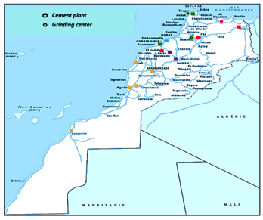
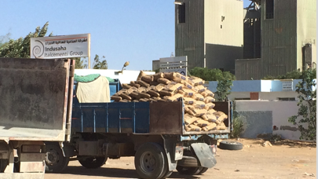
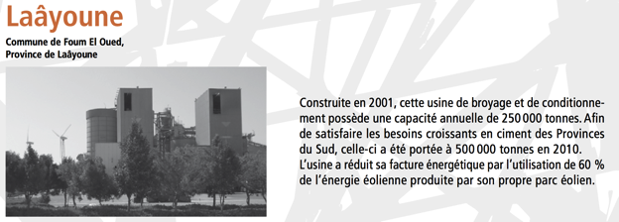
South Morocco Market Area
Indusaha as a reference
INDUSAHA Cement Grinding Plant 55t/h in Laayoune, South Morocco (90km from Tarfaya)*
Year Sales (MAD) Sales (€) Net Profit (MAD) Net Profit (€)
2015 MAD 385,553,673 €35.3 million MAD 169,864,744 €15.6 million
2014 MAD 426,454,000 €39.1 million MAD 124,303,000 €11.4 million
MAD 445,024,000 €40.8 million MAD 121,432,000 €11.1 million
MAD 417,687,000 €38.3 million MAD 107,591,000 €9.9 million
2011 MAD 358,674,000 €32.9 million MAD 84,463,000 €7.7 million
2010 MAD 294,369,000 €27.0 million MAD 70,845,000 €6.5 million
2009 MAD 285,246,000 € 26.2 million MAD 69,791,000 €6.4 million
* Part of Ciments du Maroc and Heidelberg – and 1,000 tons per day production in Laayoune

Slide 16








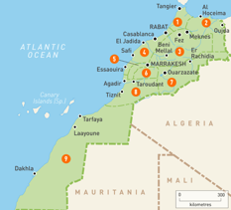

South Morocco Market Area
Main Focus on Guelmin Oued Noun Region
Cemos Phase2 location
Cemos Ciment (Tarfaya) – CCG1 0.27Mt
Lafarge Holcim (France) – Tetouan ICP 2Mt, Meknes ICP 1.8Mt, Fez ICP 0.5Mt, Oudja ICP 1.6Mt, Settat ICP 1.8Mt,Bouskoura ICP 2.6Mt, Tanger CGU 1Mt, Nador CGU 0.4Mt, Laayoune CGU launch 0.22Mt
Heidelberg (Germany) - Agadir ICP 2.2Mt, Safi ICP 0.5Mt, Marrakesh ICP 1.4MT, Jorf Lasfar CGU 0.45Mt + Laayoune CGU 0.5 Mt
Votorantim (Brazil) - Tenerife CGU 0.25Mt and Gran Canaria CGU 0.25Mt + Rabat ICP 0.9Mt. Not present in South Morocco.
Votorantim (Brazil) – Casablanca ICP 1.6Mt, Beni Mellal ICP 1.6t + Rabat ICP 0.9Mt. + 10 CGU plants in West & Central Africa CIMAF with 0.35Mt – 1Mt range. Not present in South Morocco.

Slide 17
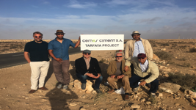
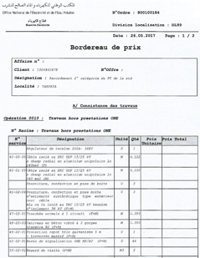
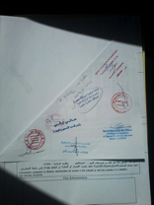
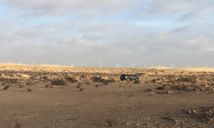
Tarfaya Licensing
All Key Licenses Received
Cemos Group Plc – Involved in South Morocco for more than 4 years with MOU on Tarfaya oil shale with ONHYM (Office National de Hydrocarbon et Mines) and in preparing CCG1 plant launch
CRI Government Main Licenses and Project Approvals – Centre Regionale d’Investments has approved cement production and project licenses for Cemos Ciment S.A. in 2017, with confirmations by all relevant ministries in Morocco
Conditional Land Purchase – Cemos Ciment completed the land acquisiton in June 2017 for an 51,760 m2 Cement Production Site in Tarfaya
Construction Permit – Obtained in September 2017 by Tarfaya / Tah authorities
Electricity Supply – Electricity supply agreement signed with ONEE (Office National d’Electricitee et Eau) in 2017
Environmental Permit – Pending completion by YE 2017

Slide 18
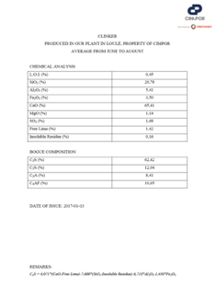
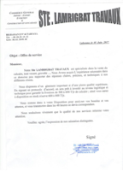
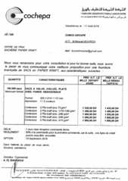
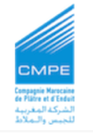
Key Suppliers
All Suppliers Prepared for Production
Cemos Ciment Production launch – All suppliers confirmed with fixed offers
Clinker – CIMPOR, Faro, Portugal (Faro – Tarfaya or Laayoune Port 2 x day shipping)
Limestone – LAMIGRAT, Tarfaya, Morocco (€ 7 / t) delivery to plant
Gypsum – CMPE, Safi, Morocco (€32 / ton) delivery to plant
Cement bags – COCHEPA, Casablanca – Morocco (€0.15 per bag) delivery to plant
Electricity – ONEE, Tarfaya (€0.09 / kwh) Connection 100% to plant
Manpower – ANAPEC, Tarfaya / Laayoune / Tan Tan area, 3 months hiring process

Slide 19
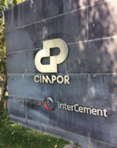
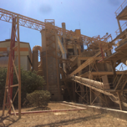
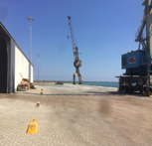
InterCement / CIMPOR
Main Clinker Supplier
Cimpor – Cimentos de Portugal is the largest Portuguese cement group, operating in eleven countries - Portugal, Spain, Morocco, Brazil, Tunisia, Turkey, Cape Verde, Mozambique, China, Egypt and South Africa, involved in manufacturing and marketing cement, hydraulic lime, concrete and aggregates, precast concrete and dry mortars. The Brazilian company Camargo Corrêa is the owner of the company
Clinker prices at low levels – World clinker prices have softened with the 2014 oil prices changes and lower petcoke and shipping costs, so current clinker ranging US$ 35 / ton and beneficial situation for cement grinders
Long term supply for clinker in progress – Cemos is currently negotiating a long term supply agreement with InterCement / CIMPOR for supporting Cemos’ CCG strategy in various locations, starting Tarfaya CCG1
CIMPOR – Terminal at Faro capable to load vessels 6.000 DWT and Cemos is in process of confirming new extension Tarfaya Port capacity and applying for port operations concession

Slide 20
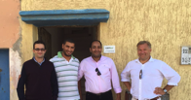
Cemos Ciment S.A.
Operational Chart
General Director
Production
Commercial
Finance / Admin
New Products / R&D
Cement Production
Sales
Accounting
Product Development
Procurement
Dispatch
HR
Phase 2
Warehouse
Distribution
HSSE
IT
Quality Control Laboratory

Slide 21

Primtec O&M Services
5 x Person Loesche O&M Team
 | # | Shift
Process engineer | 2 | One per shift
Mechanical Supervisor | 2 | One per shift (max. 2 shifts)
EC&I Engineer | 1 | Day shift
Total | 5
Primetec (Loesche) – O&M services for initial 12 to 18 month period following post commissioning ”hand over”
Loesche EPC for Assembly & Commissioning – Loesche responsible for CCG1 assembly and installation in Tarfaya
Primetec O&M Services – On site production experts for process and mechanical engineering, local team training
Total Production Staff – Primetec 5 x specialists and Cemos Ciment S.A. 50 person production staff in 2 shifts

Slide 22
Phase 2 Tarfaya Oil Shale
Limestone Based Oil Shale Resource
Tarfaya Oil Shale Resource – World class oil shale resource at the Atlantic Coast, in a strategic location for Africa
Tarfaya Oil Shale Use for Cement – Limestone rich (CaO 63%) oil shale ash, unique for low cost & low CO2 cement production
Cemos rights for Block 1 – Cemos extending MOU on 1 billion ton (JORC) Block 1 with Ministry of Mines & Energy
Cemos Phase2 project with Tarfaya oil shale – Technical Development phase for clinker & energy production
Tarfaya Oil Shale
LIMESTONE
-------------
SAND
-------------
BITUMEN OIL SHALE
Sand + Limestone

Slide 23
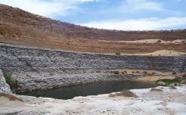
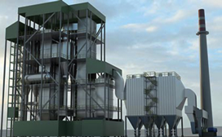

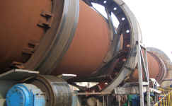
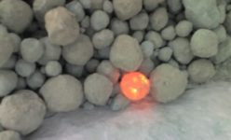
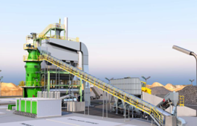
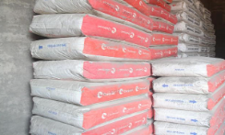
Phase 2 Tarfaya Oil Shale
Clinker and Own Energy Production
Limestone based Oil shale mine
Feedstock for clinker & energy
CFB Boilers for raw oil shale
Production of heat & power & ash
Clinker Kiln as part of cement plant
Production of clinker from CFB ash
Clinker as raw material for CCGs
Production of clinker for grinding
Clinker grinding with Loesche CCGs
Production of cement with 5 x CCGs
Final Cement from CCG grinders
Final cement in bags or bulk
Oil Shale for Clinker & Cement Benefits – include low cost clinker & cement production, low CO2 emissions and low cost export of clinker & cement with strategic location on the Atlantic and option for an export port, as BOT with the Moroccan government.

